Slide 1

GENG-8900 MACHINE LEARNING
Instructor: Dr. Yasser Alginahi
Convolutional Neural Networks (CNNs)
Date: 27-Oct-2023
Ifrah Andleeb
Vaibhav Anilkumar Patel
1

Slide 2
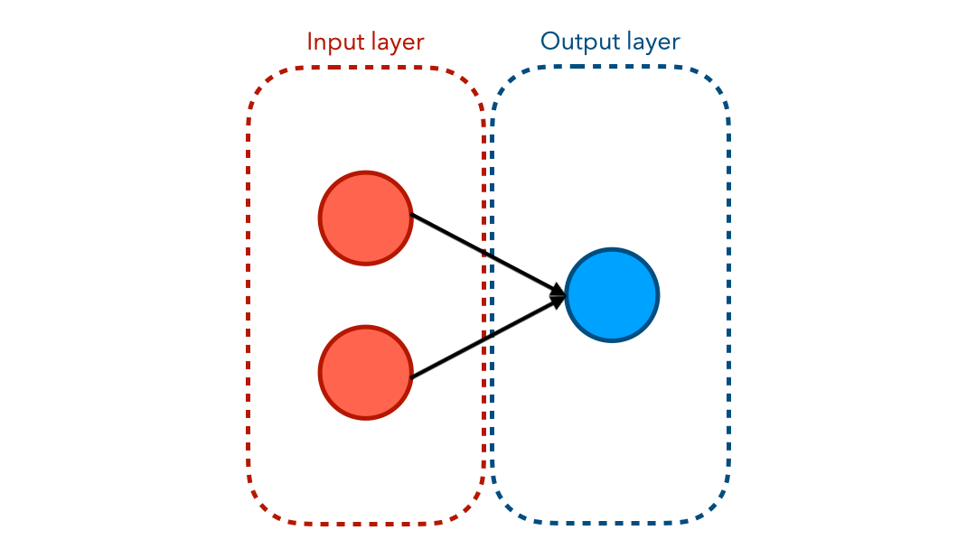
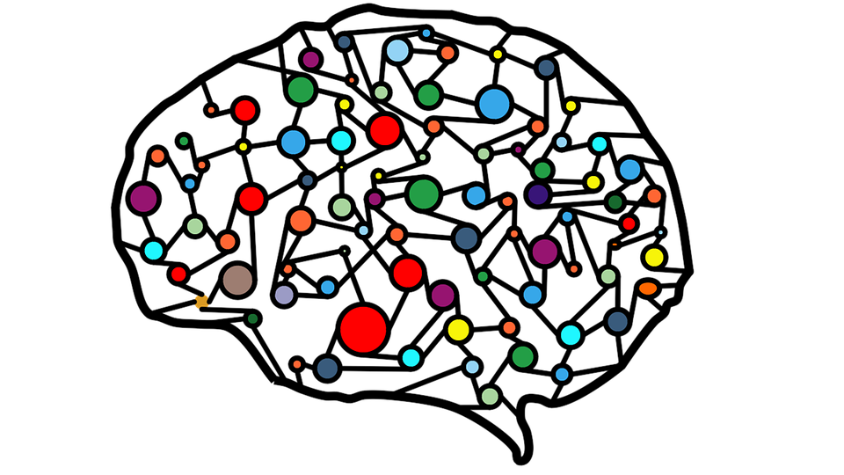
What are Neural Networks ?
A neural network is like a computer program inspired by the human brain.
So, in a neural network, neurons receive, think about, and then share information, and by doing this collectively, they can solve all sorts of problems.
Neural Network Animated [https://tinyurl.com/28wmb4ez]
Brain Network [https://tinyurl.com/4fcta8j7]
2

Slide 3
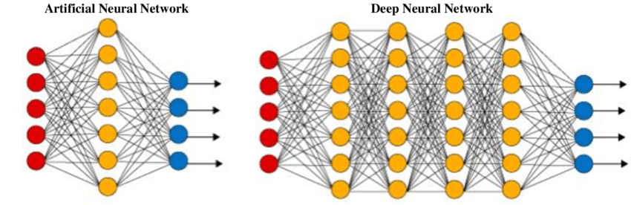
Artificial Neural Networks vs Deep Neural Networks
Input Layer
Output Layer
Input Layer
Output Layer
Hidden Layer
Hidden Layers
ANN vs DNN Architecture [https://www.datacamp.com/tutorial/introduction-to-deep-neural-networks]
3

Slide 4
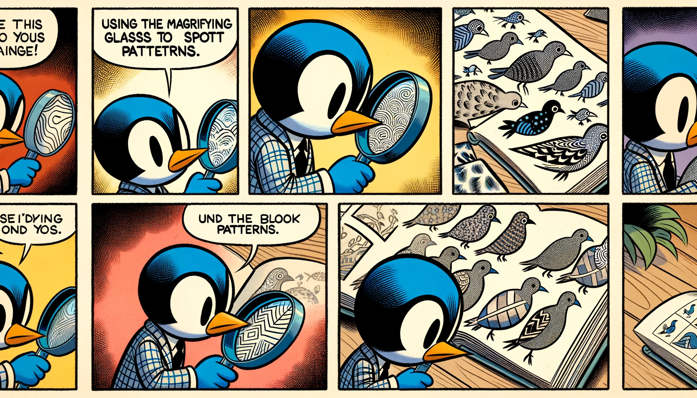
Let’s learn more !
Recognizing birds with magnifying glass [https://openai.com/dall-e-3]
4

Slide 5
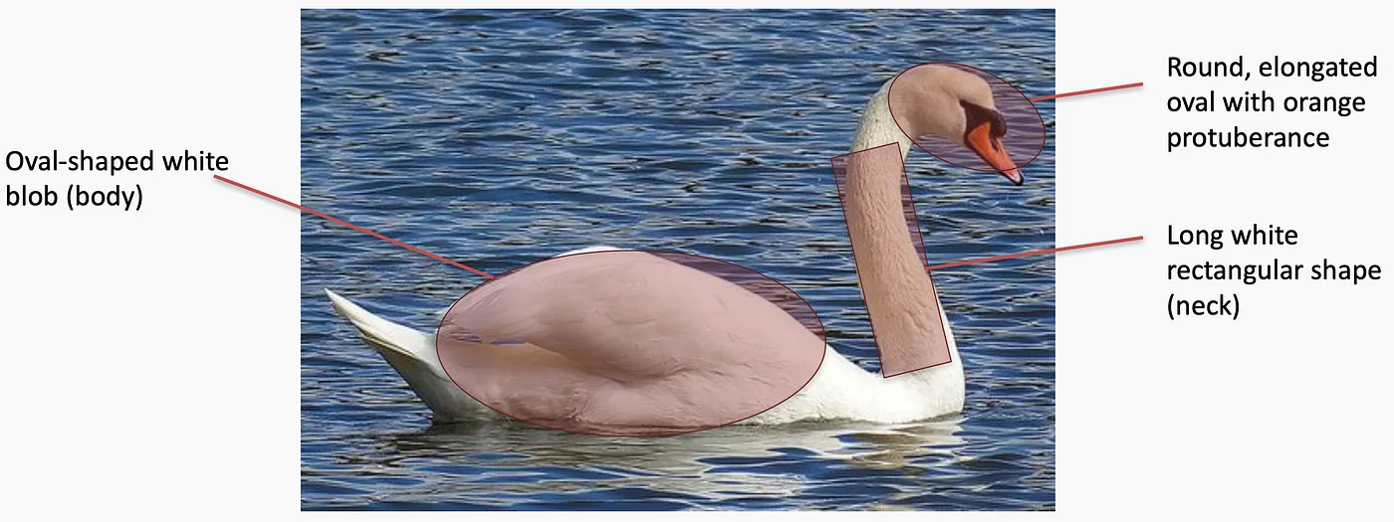
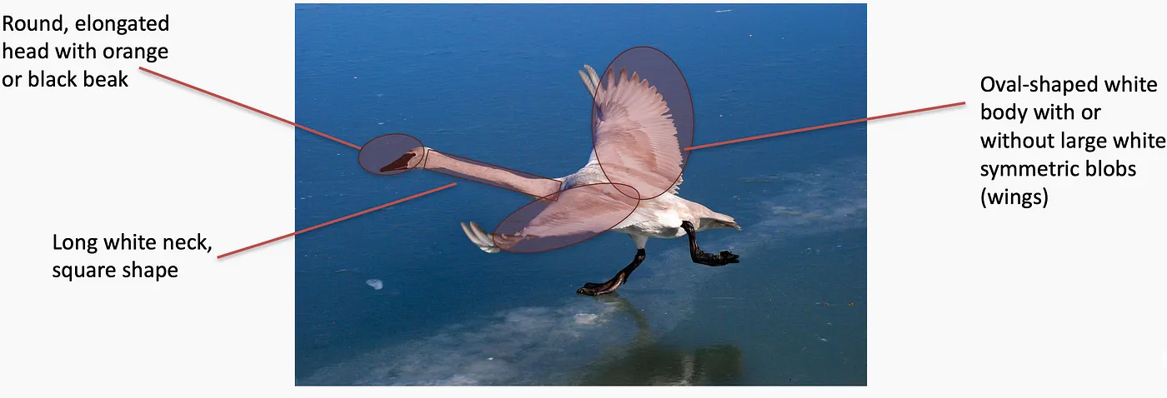
Image Analysis : How do you identify a Swan ?
Features identification in a bird [https://tinyurl.com/5n6r3xee]
5

Slide 6
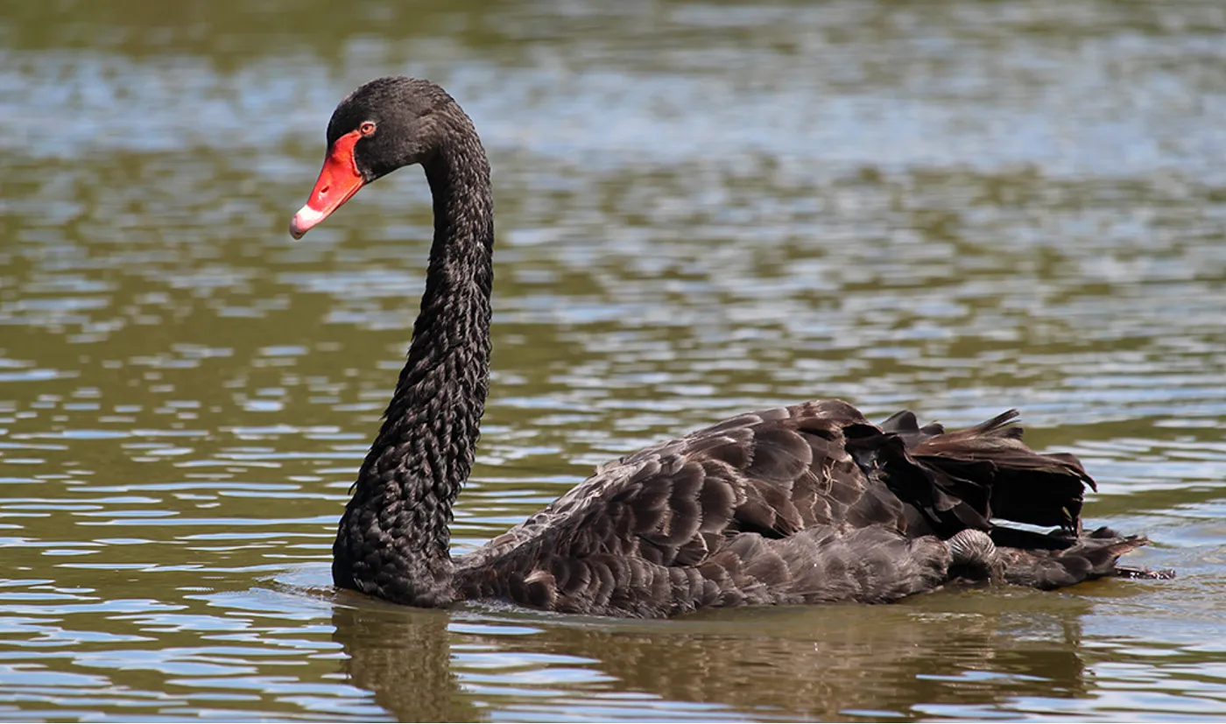
Image Analysis : How do you identify a Swan ?
Don’t forget about those black swans! [https://tinyurl.com/5n6r3xee]
6

Slide 7
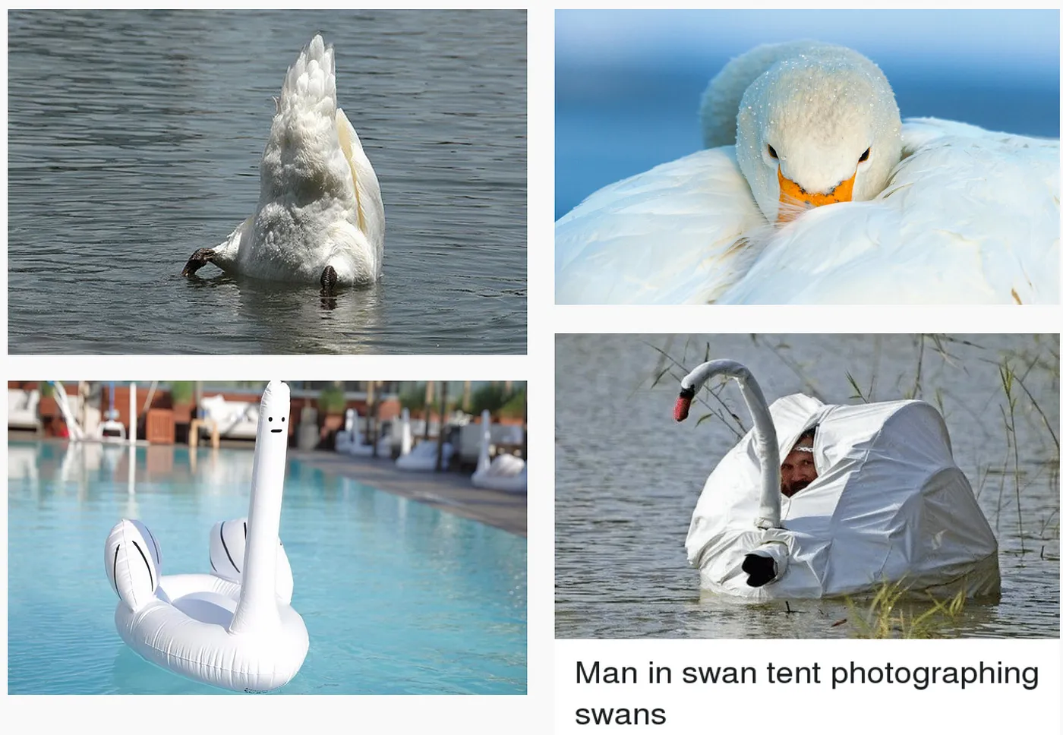
Image Analysis : How do you identify a Swan ?
Worst-case scenarios [https://tinyurl.com/5n6r3xee]
7

Slide 8
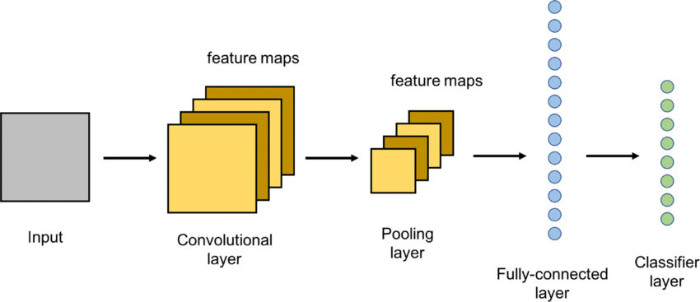
What is CNN? and Why CNN?
Deep Neural Network with multiple Layers, processes data with grids i.e. Images
With other image processing algorithms, filters are typically created based on heuristics while CNN's can learn what characteristics in the filters are the most important.
Saves a lot of time on trial and error work since we don't need as many parameters.
Huge advantage : Don’t need a lot of preprocessing of the images.
A simple CNN and its main layers [https://tinyurl.com/szpwhrpk}
8

Slide 9
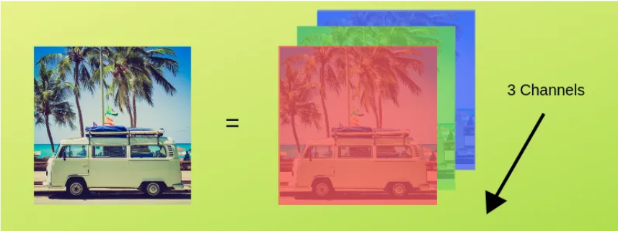
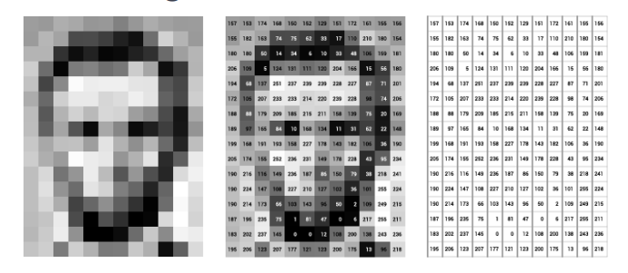
Image Representation
Plane/Channels: Separate layers in images capturing specific information.
An RGB (Red, Blue and Green) image is a matrix of pixel values having 3 planes.
Whereas a grayscale image is the same but it has a single plane.
RGB Representation of an image - [https://tinyurl.com/yrw7zw8t]
Gray scale Representation of an image [https://www.v7labs.com/blog/image-recognition-guide]
9

Slide 10
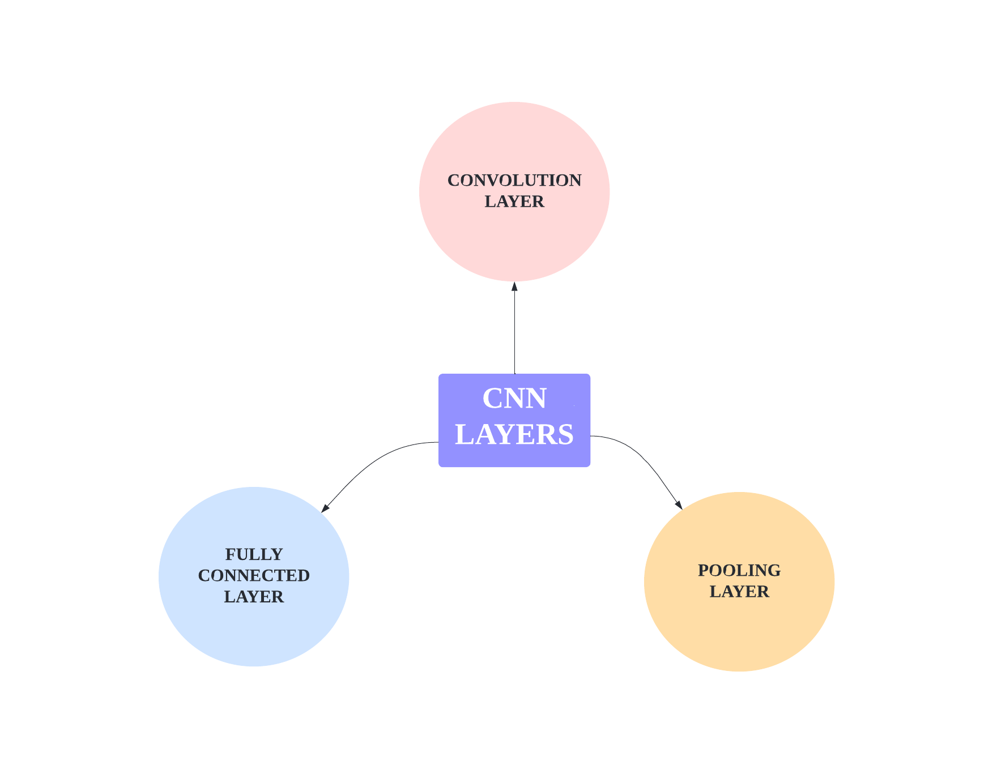
Different Layers in CNN
Filters input data to detect specific features.
Reduces data size while preserving important features.
Links every neuron to previous layers’ outputs.
CNN Layers
10

Slide 11
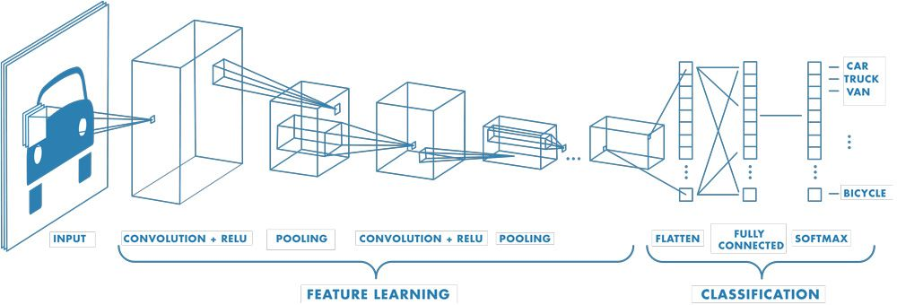
Internal Workflow of CNNs
Basic CNN Architecture [https://tinyurl.com/5b3ecseh]
11

Slide 12
Different Layers in CNN
Filters input data to detect specific features.
Reduces data size while preserving important features.
Links every neuron to previous layers’ outputs.
CNN Layers
12

Slide 13
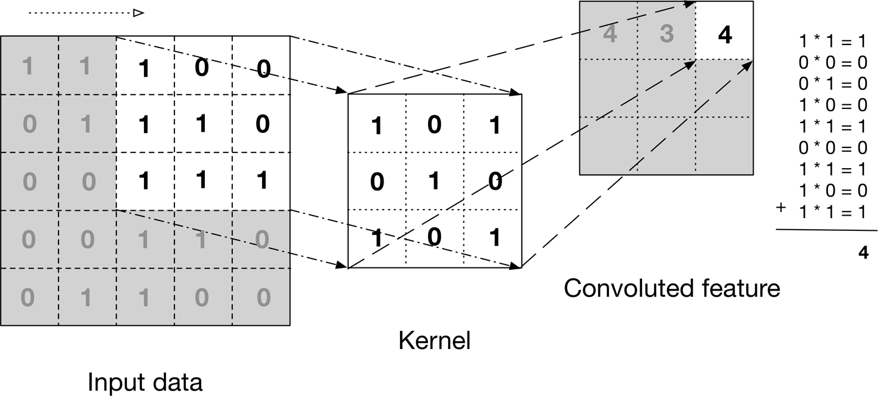
Convolution Layer
A convolution layer in a CNN applies a set of learnable filters (Kernel functions) to input image, detecting spatial features like edges, patterns or textures in an image.
Convolutional Layers are vital for extracting meaningful features from raw data
Illustration of Convolution Operation [https://www.analyticsvidhya.com/blog/2021/05/convolutional-neural-networks-cnn/]
13

Slide 14


Kernel
Kernel function: A small filter that slide over an image to extract features from it.
Places a filter/kernel over an array of image pixels & creates a convolved feature map.
Illustration of Convolution Operation [https://tinyurl.com/5u3vx4dk]
Illustration of Convolution Operation [https://tinyurl.com/3kjsmhcp]
14

Slide 15
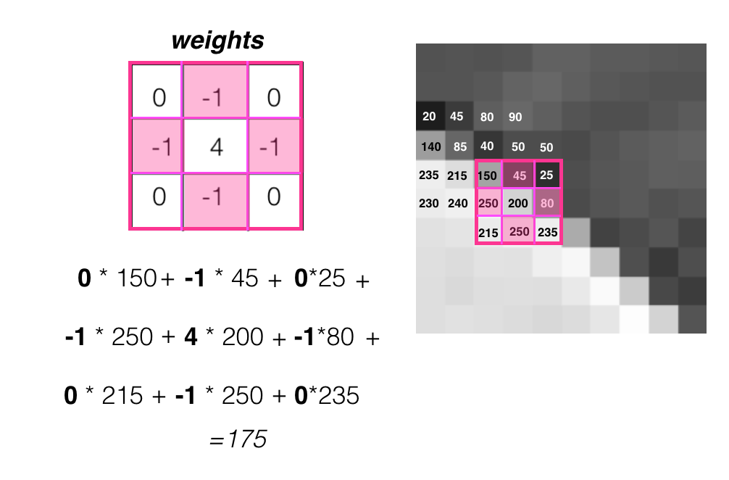
Weights
These weights determine what specific patterns or features the filter is looking for in the input data
Weights are optimized during training
Weight Optimization [https://cezannec.github.io/Convolutional_Neural_Networks/]
15

Slide 16
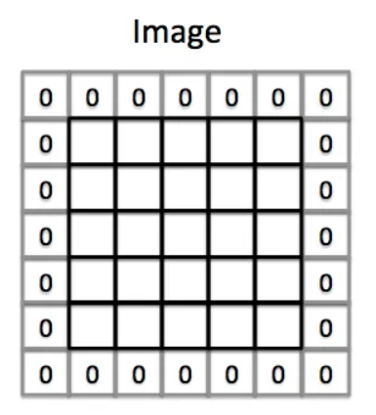
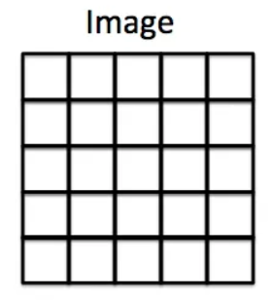
Padding
Drawback of Kernel function: Focuses more on the center than the corners
Padding is the solution! : Adding extra pixels on the borders.
Zero padding : A column and row of zeros are added on each side of the input image.
Padding Operation [https://medium.com/machine-learning-algorithms/what-is-padding-in-convolutional-neural-network-c120077469cc]
16

Slide 17
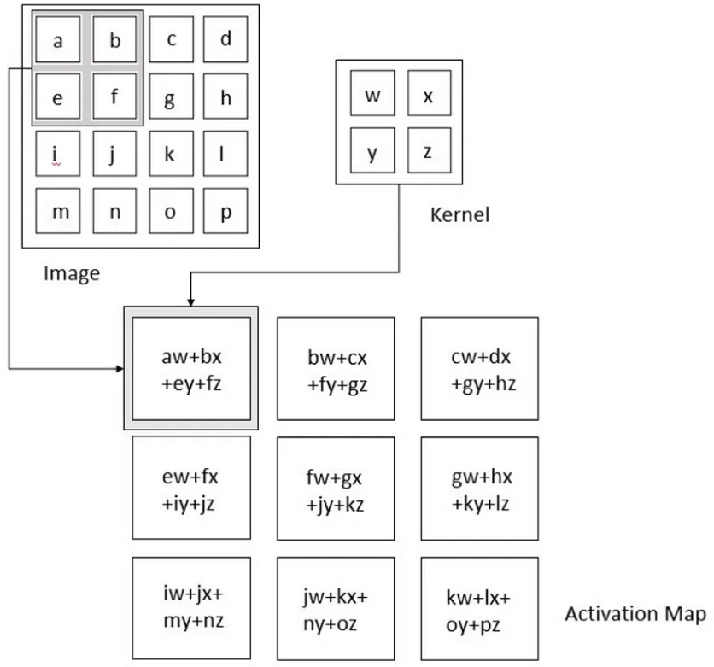
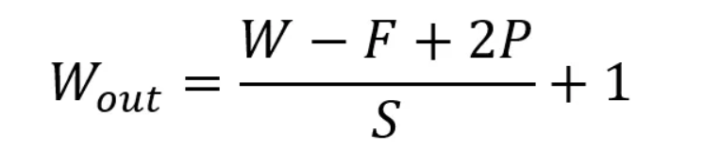
Convolution Layer
Size of output volume can be determined by the following formula:
where W = height/width of the image
D = number of channels
Spatial size (F) = Kernel dimensions (width x height)
Stride (S) = number of pixels by which a kernel or filter is moved across
Padding (P) = Any extra padded borders
This will yield an output volume of size Wout x Wout x Dout.
Convolution Operation
[https://doi.org/10.1007/s10710-017-9314-z]
17

Slide 18
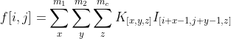
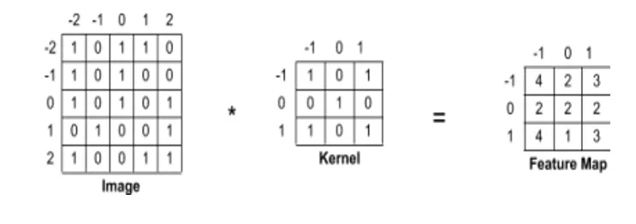
Convolution Layer
Dimension of the image (I) = W1 x W2 x Wc (height x width x channels)
Dimension of the filter (K) = n1 x n2 x nc (height x width x channels)
(Where nc = Wc)
Feature Map F_{[i,j]} = (I * K)_{[i,j]} =>
Calculation of values of the Feature Map
https://doi.org/10.1007/s11042-019-08385-4
18

Slide 19
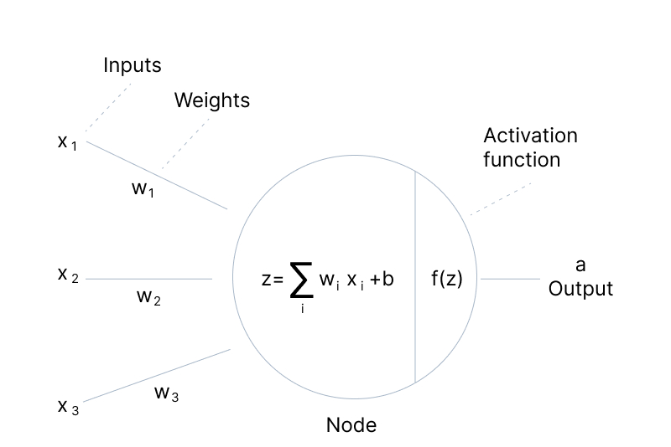
Activation Functions in Convolution Layer
Activation functions are used to learn complex patterns in data.
Transform the weighted sum of inputs to determine the neuron's output or "activation."
The Activation Functions can be basically divided into 2 types-
Linear Activation Function
Non-linear Activation Functions
Activation Functions in CNNs [https://tinyurl.com/hbk3f5k9]
19

Slide 20
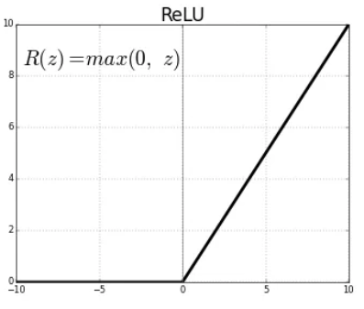
Rectified Linear Unit (Relu)
It computes the function f(x)=max(0,x). In other words, the activation is simply thresholded at zero
The function returns 0 if it receives any negative input, but for any positive value x, it returns that value back.
Padding Operation [https://tinyurl.com/32fa5f5h]
20

Slide 21
Different Layers in CNN
Filters input data to detect specific features.
Links every neuron to previous layers’ outputs.
Reduces data size while preserving important features.
CNN Layers
21

Slide 22
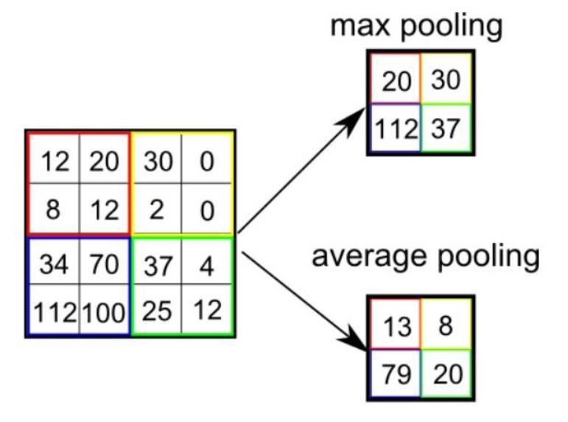
Pooling Layer
Responsible for reducing the spatial size of the Convolved Feature
Aim is to decrease computational power required to process the data by reducing the dimensions
There are two types of pooling.
Average Pooling
Returns the average of all the values from the portion of the image covered by the Kernel.
Simply performs dimensionality reduction as a noise suppressing mechanism.
Basic CNN Architecture [https://tinyurl.com/5b3ecseh]
Illustration of Max Pooling and Average Pooling layers [https://tinyurl.com/5n6umca5]
22

Slide 23
Pooling Layer
Max Pooling
Find the maximum value from a portion of the image covered by the kernel.
Discards the noisy activations altogether
Performs de-noising along with dimensionality reduction.
Illustration of Max Pooling and Average Pooling layers [https://tinyurl.com/5n6umca5]
23

Slide 24
Different Layers in CNN
Filters input data to detect specific features.
Links every neuron to previous layers’ outputs.
Reduces data size while preserving important features.
CNN Layers
24

Slide 25
Fully Connected Layer
Once the features extracted by the convolution layers and downsampled by the pooling layers are created, they are mapped by a subset of fully connected layers to the final outputs of the network, such as the probabilities for each class in classification tasks.
The final fully connected layer typically has the same number of output nodes as the number of classes. Each fully connected layer is followed by a nonlinear function, such as ReLU
Basic CNN Architecture [https://tinyurl.com/5b3ecseh]
25

Slide 26
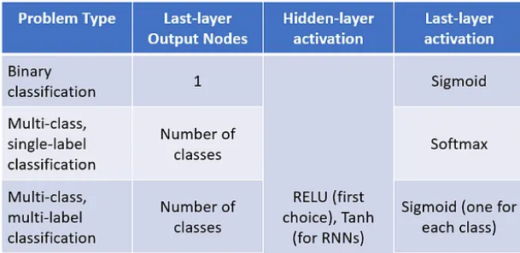
Activation Functions used in Fully Connected Layer
Table - Different Activation Functions used in Hidden and Output Layer
Different Activation functions [https://tinyurl.com/5n8cdwze]
26

Slide 27
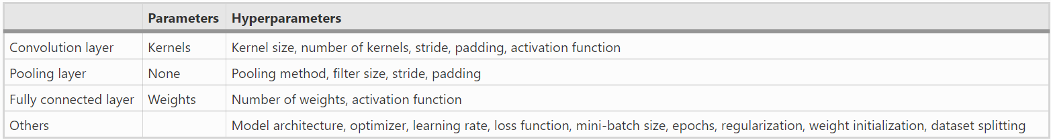
A list of parameters and hyperparameters in a convolutional neural network (CNN)
Table - Summary for CNN Layers
https://doi.org/10.1007/s13244-018-0639-9
27

Slide 28
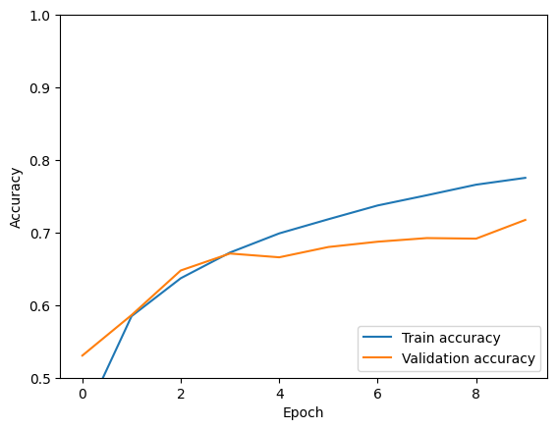
Evaluation Metrics
Accuracy (Correct/Total Predictions)
Train Accuracy : High training accuracy doesn't guarantee good performance on unseen data.
Test Accuracy (on unseen data): High test accuracy == Model generalizes well to new data.
Validation Accuracy : to tune hyperparameters and prevent overfitting during training
provides an interim check on the model's performance.
Our Model’s Train Vs. Val Accuracy [https://tinyurl.com/mycnn01]
28

Slide 29
Evaluation Metrics
Classification Loss functions
Binary Cross Entropy Loss/Negative Log Likelihood
As the predicted probability diverges from the actual label, cross-entropy loss increases.
Here,
yi = Value of the Actual Label
ŷi = Value of the Predicted Label
Binary Cross Entropy Loss [https://tinyurl.com/3w9y86ed]
29

Slide 30
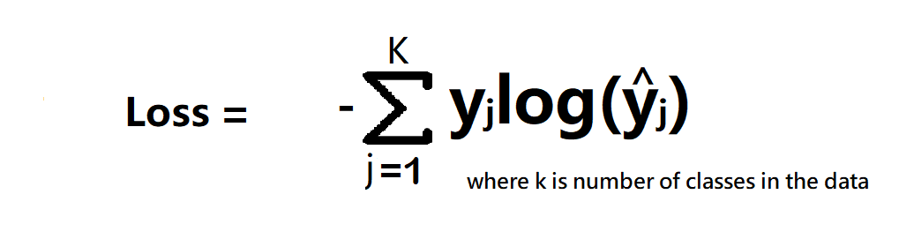
Evaluation Metrics
Classification Loss functions
Categorical Cross Entropy
Same as binary, but for multiclass classification
Here,
yj = Value of the Actual Label
ŷj = Value of the Predicted Label
Categorical Cross Entropy Loss [https://tinyurl.com/3w9y86ed]
30

Slide 31
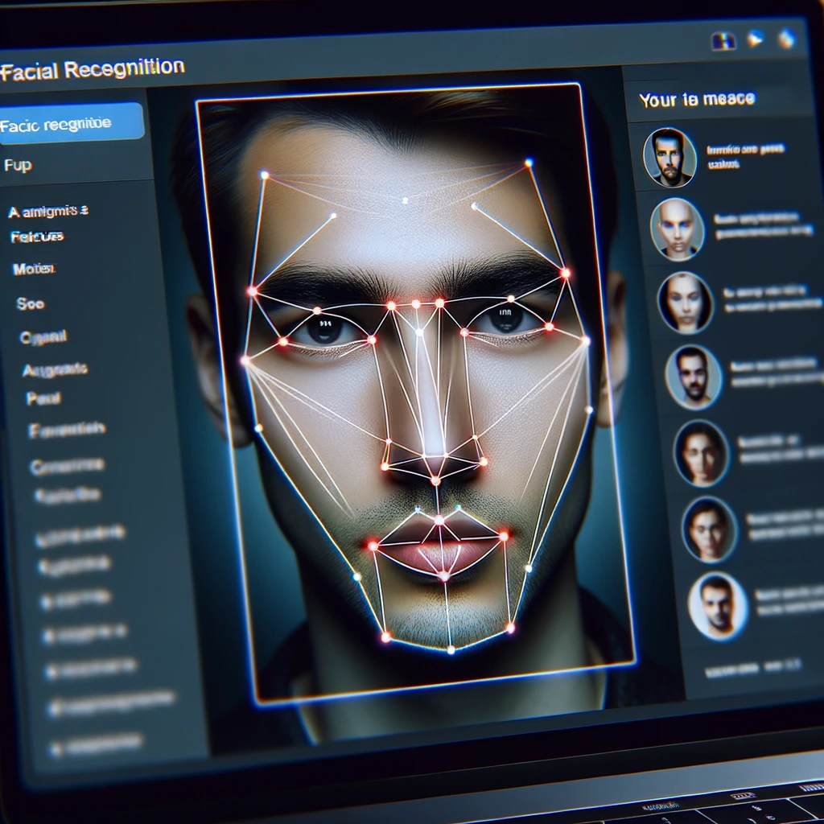



Applications of CNN
Decoding Facial Recognition
Identifying every face and unique features
Analyzing Documents
Optical Character Recognition (OCR), Signature Verification
Understanding Climate
Cloud Detection & Classification, Extreme Weather Event Prediction
Advertising
Understanding buying patterns and data-driven personalized advertising
Collecting Historic and Environmental Elements
Identification of Historic Artifact and various species in the environment
Applications of CNN [https://openai.com/dall-e-3]
31

Slide 32

Implementation of CNN
Libraries for NN:
Deep Learning Libraries [https://tinyurl.com/52fnc5eu]
Demo Implementation : https://tinyurl.com/mycnn01
32

Slide 33
Paper References
[1] Heaton, J. Ian Goodfellow, Yoshua Bengio, and Aaron Courville: Deep learning. Genet Program Evolvable Mach 19, 305–307 (2018). https://doi.org/10.1007/s10710-017-9314-z
[2] Zaniolo, L., Marques, O. On the use of variable stride in convolutional neural networks. Multimed Tools Appl 79, 13581–13598 (2020). https://doi.org/10.1007/s11042-019-08385-4
[3] Yamashita, R., Nishio, M., Do, R.K.G. et al. Convolutional neural networks: an overview and application in radiology. Insights Imaging 9, 611–629 (2018). https://doi.org/10.1007/s13244-018-0639-9
[4] Kumar, Vaibhav & L., M.. (2018). Deep Learning as a Frontier of Machine Learning: A Review. International Journal of Computer Applications. 182. 22-30. 10.5120/ijca2018917433.
[5]Alzubaidi, L., Zhang, J., Humaidi, A.J. et al. Review of deep learning: concepts, CNN architectures, challenges, applications, future directions. J Big Data 8, 53 (2021). https://doi.org/10.1186/s40537-021-00444-8
33

Slide 34
Video References
What is a convolutional neural network (CNN)? [https://youtu.be/K_BHmztRTpA?si=ZMw-jJv6NYZCwYcb]
Convolutional Neural Network Tutorial (CNN) | How CNN Works | Deep Learning Tutorial | Simplilearn[https://youtu.be/Jy9-aGMB_TE?si=Ob8qf05jDnoWBd7g]
Simple explanation of convolutional neural network | Deep Learning Tutorial 23 (Tensorflow & Python)[https://youtu.be/zfiSAzpy9NM?si=qJ6vCc9cqpiDSAw7]
34

Slide 35
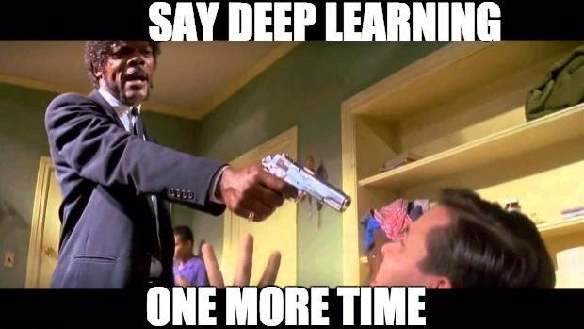
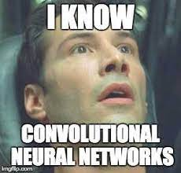
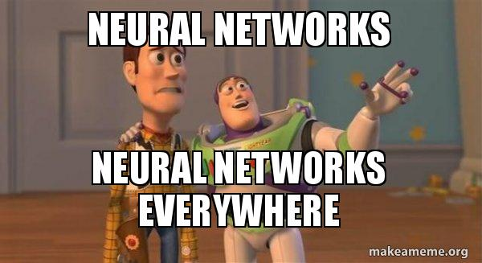
35

